Slide 1
PART III
Data Link Layer

Slide 2
PART III
Data Link Layer

Slide 3

Position of the data-link layer

Slide 4
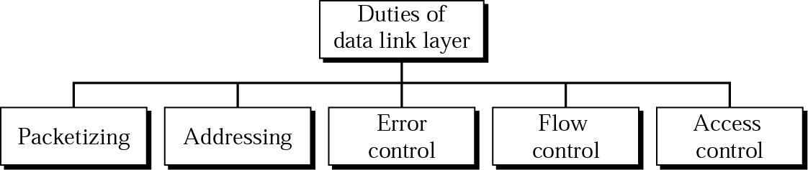
Data link layer duties

Slide 5
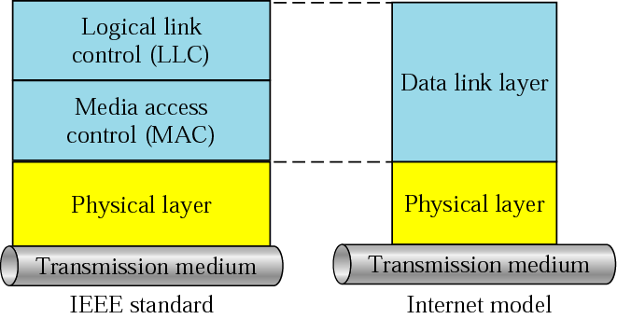
LLC and MAC sublayers

Slide 6
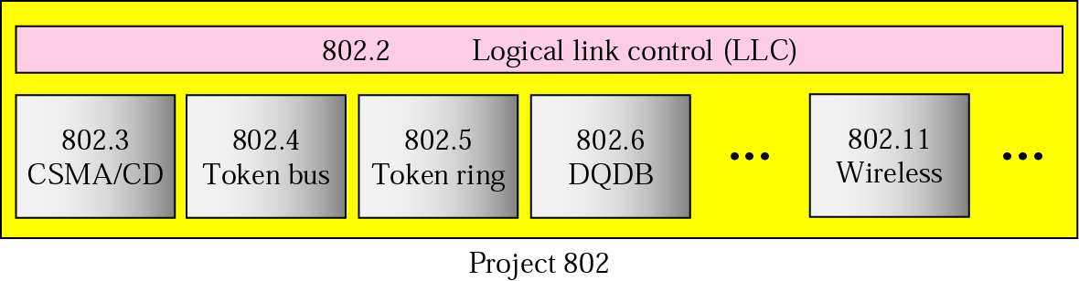
IEEE standards for LANs

Slide 7
Chapters
Chapter 10 Error Detection and Correction
Chapter 11 Data Link Control and Protocols
Chapter 12 Point-To-Point Access
Chapter 13 Multiple Access
Chapter 14 Local Area Networks
Chapter 15 Wireless LANs
Chapter 16 Connecting LANs
Chapter 17 Cellular Telephone and Satellite Networks
Chapter 18 Virtual Circuit Switching

Slide 8
Chapter 10
Error Detection
and
Correction

Slide 9

Note:
Data can be corrupted during transmission. For reliable communication, errors must be detected and corrected.

Slide 10
10.1 Types of Error
Single-Bit Error
Burst Error

Slide 11
Note:
In a single-bit error, only one bit in the data unit has changed.

Slide 12
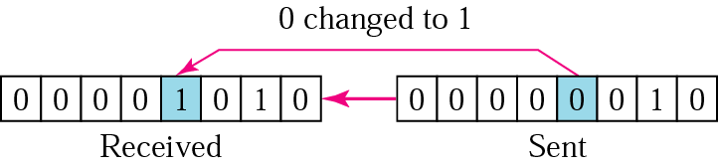
10.1 Single-bit error

Slide 13
Note:
A burst error means that 2 or more bits in the data unit have
changed.

Slide 14
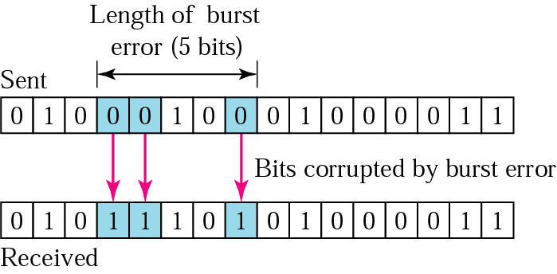
10.2 Burst error of length 5

Slide 15
10.2 Detection
Redundancy
    Parity Check
    Cyclic Redundancy Check (CRC)
    Checksum

Slide 16
Note:
Error detection uses the concept of redundancy, which means adding extra bits for detecting errors at the destination.

Slide 17
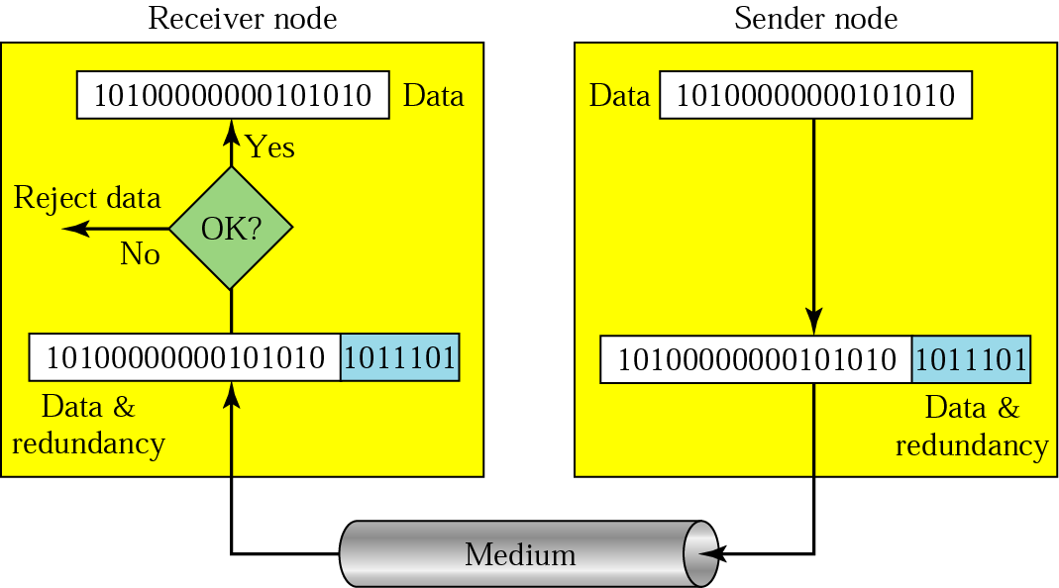
10.3 Redundancy

Slide 18
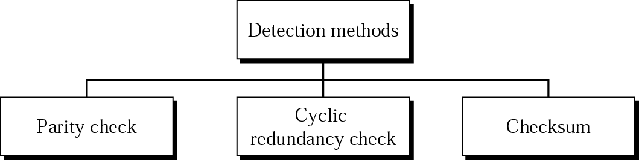
10.4 Detection methods

Slide 19
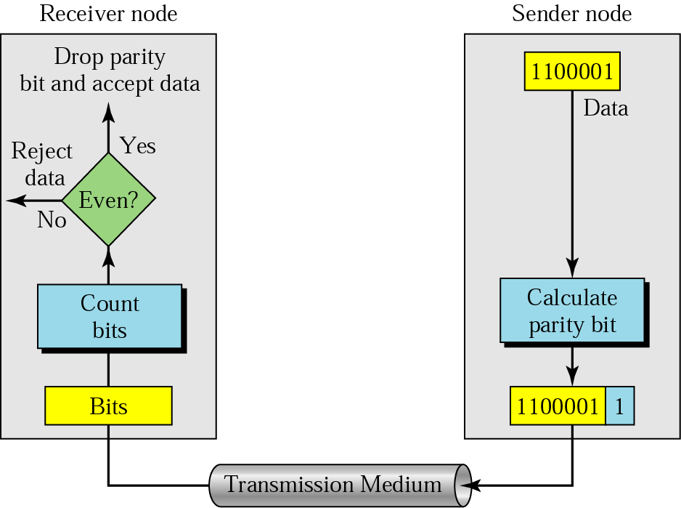
10.5 Even-parity concept

Slide 20
Note:
In parity check, a parity bit is added to every data unit so that the total number of 1s is even
(or odd for odd-parity).

Slide 21
Example 1
Suppose the sender wants to send the word world. In ASCII the five characters are coded as
1110111 1101111 1110010 1101100 1100100
The following shows the actual bits sent
11101110 11011110 11100100 11011000 11001001

Slide 22
Example 2
Now suppose the word world in Example 1 is received by the receiver without being corrupted in transmission.
11101110 11011110 11100100 11011000 11001001
The receiver counts the 1s in each character and comes up with even numbers (6, 6, 4, 4, 4). The data are accepted.

Slide 23
Example 3
Now suppose the word world in Example 1 is corrupted during transmission.
11111110 11011110 11101100 11011000 11001001
The receiver counts the 1s in each character and comes up with even and odd numbers (7, 6, 5, 4, 4). The receiver knows that the data are corrupted, discards them, and asks for retransmission.

Slide 24
Note:
Simple parity check can detect all single-bit errors. It can detect burst errors only if the total number of errors in each data
unit is odd.

Slide 25
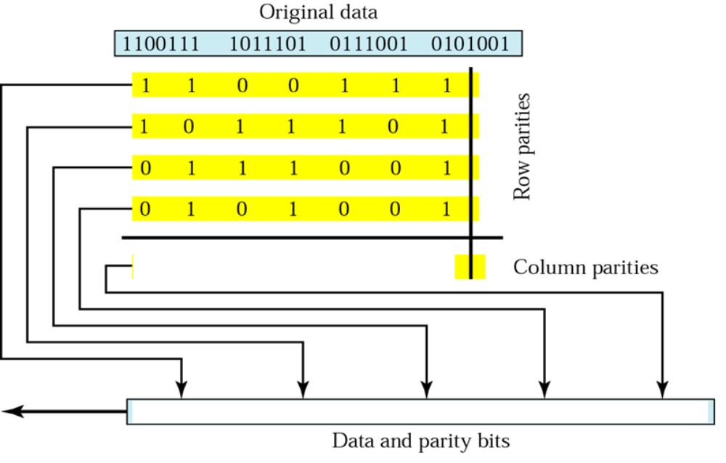
10.6 Two-dimensional parity

Slide 26
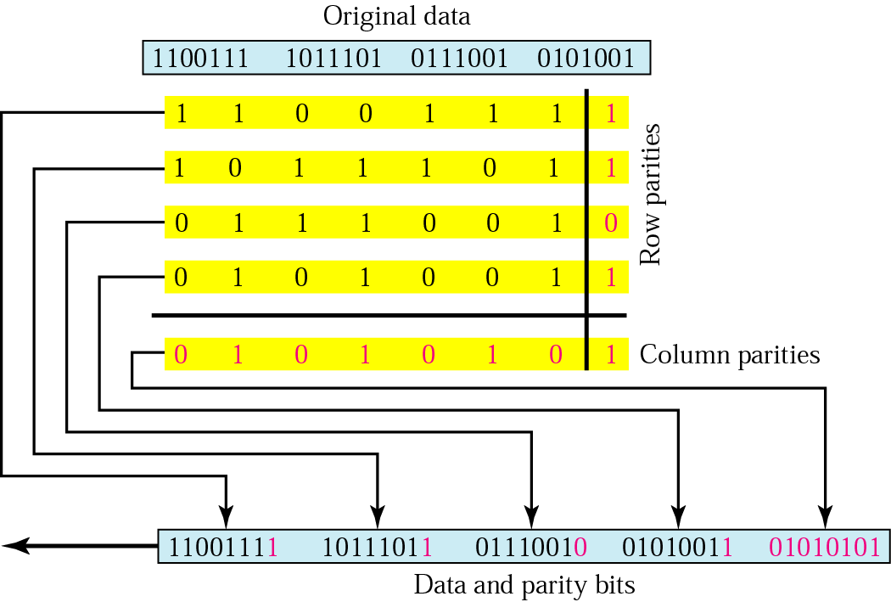
10.6 Two-dimensional parity

Slide 27
Example 4
Suppose the following block is sent:
10101001 00111001 11011101 11100111 10101010
However, it is hit by a burst noise of length 8, and some bits are corrupted.
10100011 10001001 11011101 11100111 10101010
When the receiver checks the parity bits, some of the bits do not follow the even-parity rule and the whole block is discarded.
10100011 10001001 11011101 11100111 10101010

Slide 28
Note:
In two-dimensional parity check, a block of bits is divided into rows and a redundant row of bits is added to the whole block.

Slide 29
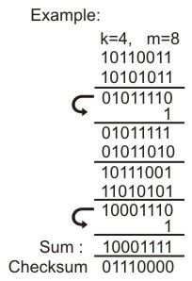
Checksum Techniques
The sender end:
The data is divided into k segments each of m bits.
The segments are added using 1’s complement arithmetic to get the sum.
The sum is complemented to get the checksum.
The checksum segment is sent along with the data segments.

Slide 30

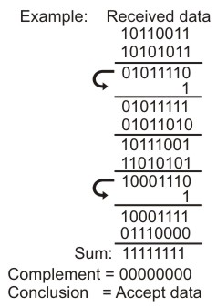
Checksum Techniques
The receiver end:
All received segments are added using 1’s complement arithmetic to get the sum.
The sum is complemented. If the result is zero, the received data is accepted; otherwise discarded,

Slide 31
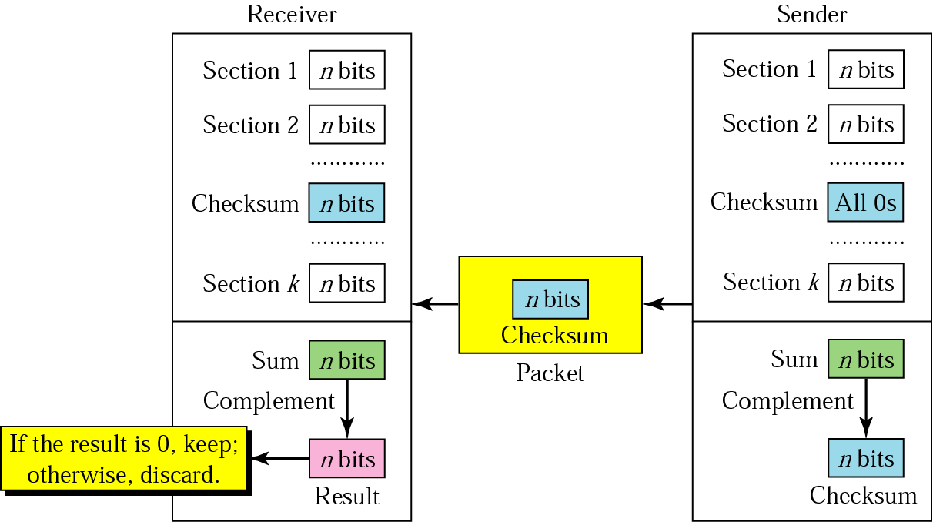
10.12 Checksum

Slide 32
Checksum Parity Check
Performance:
It detects all the errors involving an odd number of bits.
It can detect most errors involving even number of bits.
Over head is less than two dimensional parity check.

Slide 33
Example 7
Suppose the following block of 16 bits is to be sent using a checksum of 8 bits.
10101001 00111001
The numbers are added using one’s complement
10101001
00111001
------------
Sum 11100010
Checksum 00011101
The pattern sent is 10101001 00111001 00011101

Slide 34
Example 8
Now suppose the receiver receives the pattern sent in Example 7 and there is no error.
10101001 00111001 00011101
When the receiver adds the three sections, it will get all 1s, which, after complementing, is all 0s and shows that there is no error.
10101001
00111001
00011101
Sum 11111111
Complement 00000000 means that the pattern is OK.

Slide 35
Example 9
Now suppose there is a burst error of length 5 that affects 4 bits.
10101111 11111001 00011101
When the receiver adds the three sections, it gets
10101111
11111001
00011101
Partial Sum 1 11000101
Carry 1
Sum 11000110
Complement 00111001 the pattern is corrupted.

Slide 36
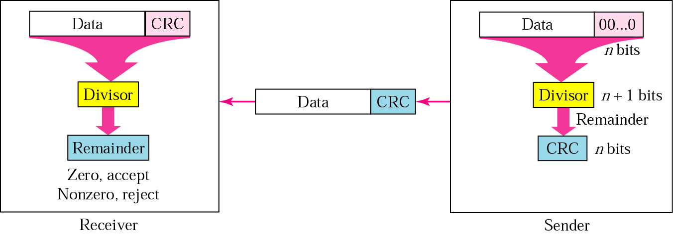
10.7 CRC generator and checker

Slide 37
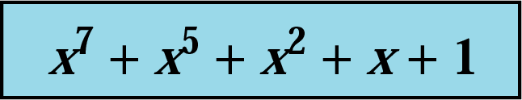
10.10 A polynomial

Slide 38
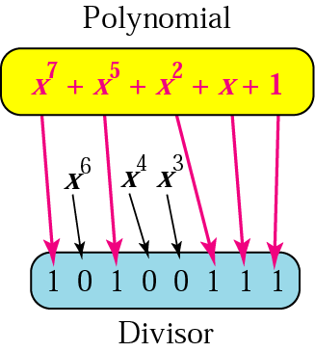
10.11 A polynomial representing a divisor

Slide 39
H/W to generate polynomial is known as Linear Feedback Shift Register
Table 10.1 Standard polynomials
Name | Polynomial | Application
CRC-8 | x⁸ + x² + x + 1 | ATM header
CRC-10 | x¹⁰ + x⁹ + x⁵ + x⁴ + x ² + 1 | ATM AAL
ITU-16 | x¹⁶ + x¹² + x⁵ + 1 | HDLC
ITU-32 | x³² + x²⁶ + x²³ + x²² + x¹⁶ + x¹² + x¹¹ + x¹⁰ + x⁸ + x⁷ + x⁵ + x⁴ + x² + x + 1 | LANs

Slide 40
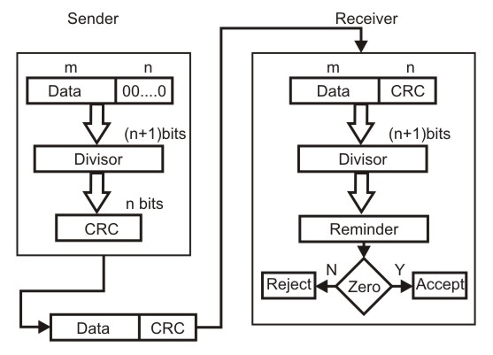
Cyclic Redundancy Check CRC

Slide 41
Cyclic Redundancy Check CRC
Cyclic Redundancy Check :
This Cyclic Redundancy Check is the most powerful and easy to implement technique.
Checksum scheme, which is based on addition, CRC is based on binary modular division.
In CRC, a sequence of redundant bits, called CRC bits, are appended to the end of data unit.

Slide 42
Cyclic Redundancy Check CRC
Cyclic Redundancy Check :
The resulting data unit becomes exactly divisible by a second, predetermined binary number.
At the destination, the incoming data unit is divided by the same number.

Slide 43
Cyclic Redundancy Check CRC
Cyclic Redundancy Check :
If at this step there is no remainder, the data unit is assumed to be correct and is therefore accepted.
A remainder indicates that the data unit has been damaged in transit and therefore must be rejected

Slide 44
Cyclic Redundancy Check CRC
CRC Approach :
If a m bit message is to be transmitted, the transmitter generates an n-bit sequence, known as Frame Check Sequence (FCS) so that the (m + n) bits are actually being transmitted.

Slide 45
Cyclic Redundancy Check CRC
CRC Approach :
Now this n -bit FCS is generated by dividing the original number, appended by n zeros, by a predetermined number.
This number, which is (n+1) bit in length, can also be considered as the coefficients of a polynomial, called Generator Polynomial.

Slide 46
Cyclic Redundancy Check CRC
CRC Approach :
The remainder of this division process generates the n - bit FCS.
On receiving the packet, the receiver divides the (m + n) bit frame by the same predetermined number and if it produces no remainder, it can be assumed that no error has occurred during the transmission

Slide 47
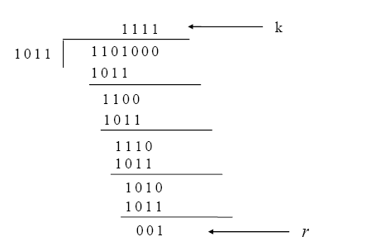
Cyclic Redundancy Check CRC

Slide 48

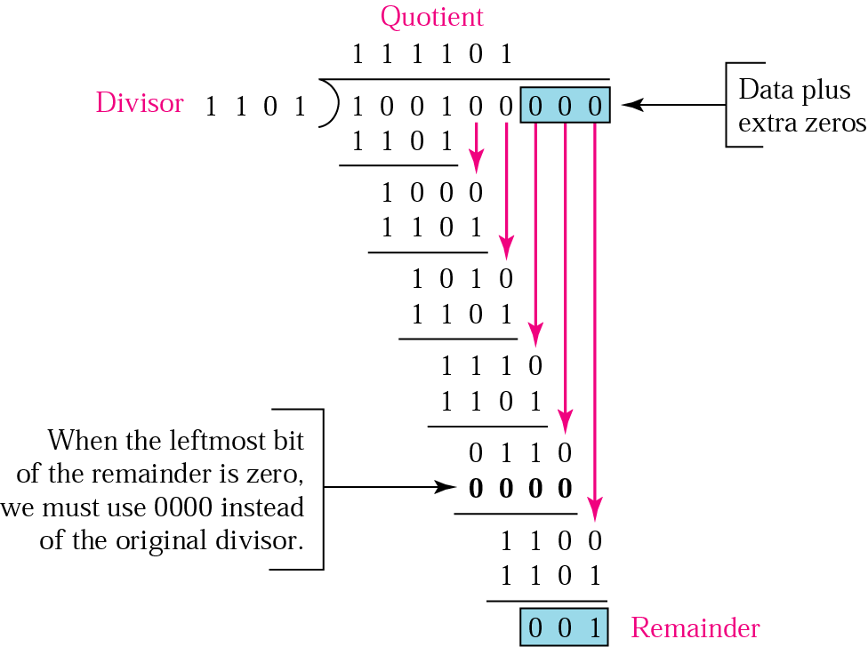

10.8 Binary division in a CRC generator

Slide 49


Slide 50
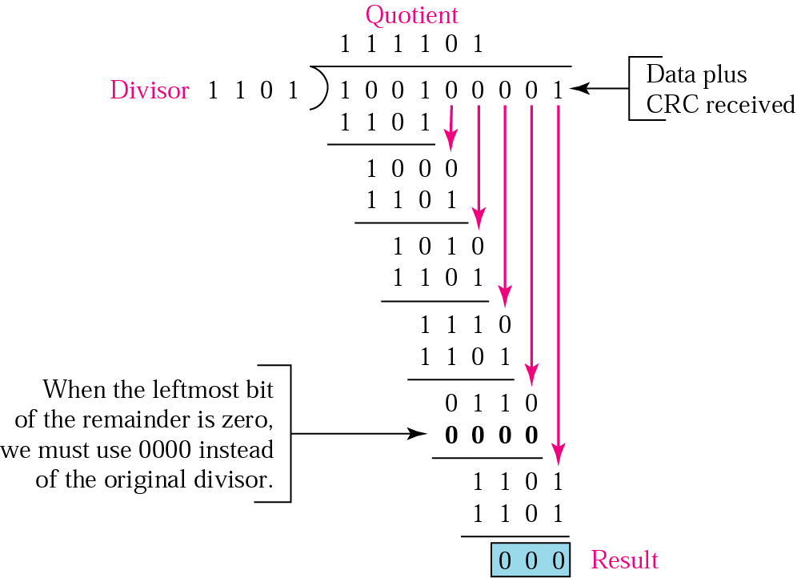
10.9 Binary division in CRC checker

Slide 51
Example 5
It is obvious that we cannot choose x (binary 10) or x² + x (binary 110) as the polynomial because both are divisible by x. However, we can choose x + 1 (binary 11) because it is not divisible by x, but is divisible by x + 1. We can also choose x² + 1 (binary 101) because it is
divisible by x + 1 (binary division).

Slide 52
Example 6
The CRC-12
x¹² + x¹¹ + x³ + x + 1
which has a degree of 12, will detect all burst errors affecting an odd number of bits, will detect all burst errors with a length less than or equal to 12, and will detect, 99.97 percent of the time, burst errors with a length of 12 or
more.

Slide 53
CRC
CRC Performance:
CRC can detect all single bit errors.
CRC can detect all double bit errors provided there are at least 3 1’s in data
CRC can detect any odd number of errors
CRC can detect all burst errors of less than the degree of polynomial.
Probability of error detection is some times 99.97 for error with a length 12 or more.

Slide 54
Error Correction Techniques
Two Basic Approaches:
Forward Error Correction
Backward error correction or Automatic Repeat Request (ARQ)

Slide 55
Error Correction Techniques
Backward error correction or Automatic Repeat Request (ARQ). When an error is detected in a frame, the sender is asked to retransmit the data/ frame.

Slide 56
Error Correction Techniques
Forward error correction: Use more redundancy in the transmitted data to not only detect but correct error in the received data. It is based on received data.

Slide 57
Error Correction Techniques
Key Idea:
  Requirement for error detection:
  A code is an error detecting code if and only if the minimum distance between any two code words is two.

Slide 58
Error Correction Techniques
Requirement for error correction:
A code is an error detecting code if and only if the minimum distance between any two code words is more than two.
Number of additional bits should such that it can point the position of the bit in error .
If k is the number of additional bits the condition 2^{k} > m + k + 1

Slide 59
Error Correction Techniques
Hamming Code:
To each group of m information bits k parity bits are added to form (m + k) bit code.
Location of each of the ( m + k ) digits is assigned a decimal value.
The k parity bits are placed in positions 1,2,…… 2^{(k-1)} positions.

Slide 60
Error Correction Techniques
Hamming Code:
k parity checks are performed on selected digits of each codeword.
At the receiving end the parity bits are recalculated. The decimal value of the k parity bits are provided the bit position in error, if any.

Slide 61
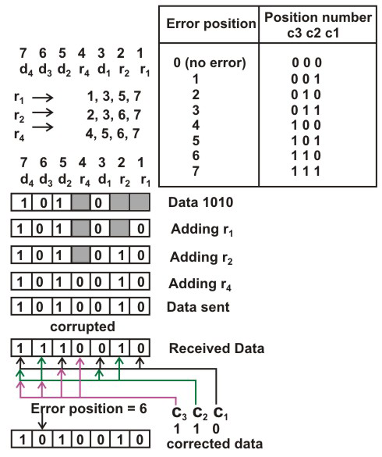
Error Correction Techniques

Slide 62
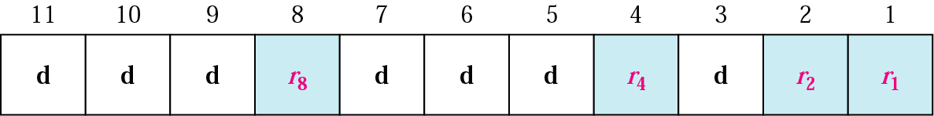
10.14 Positions of redundancy bits in Hamming code

Slide 63
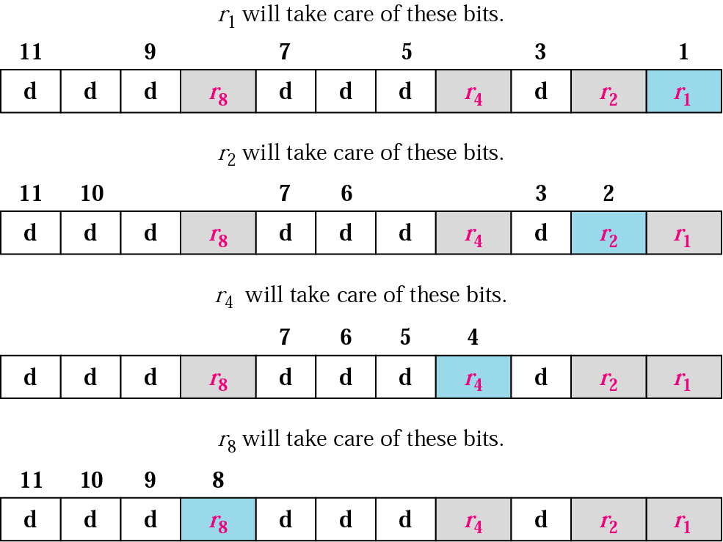
10.15 Redundancy bits calculation

Slide 64
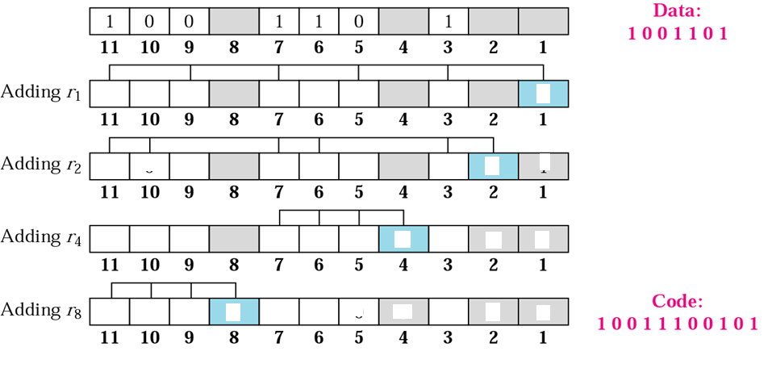
10.16 Example of redundancy bit calculation

Slide 65
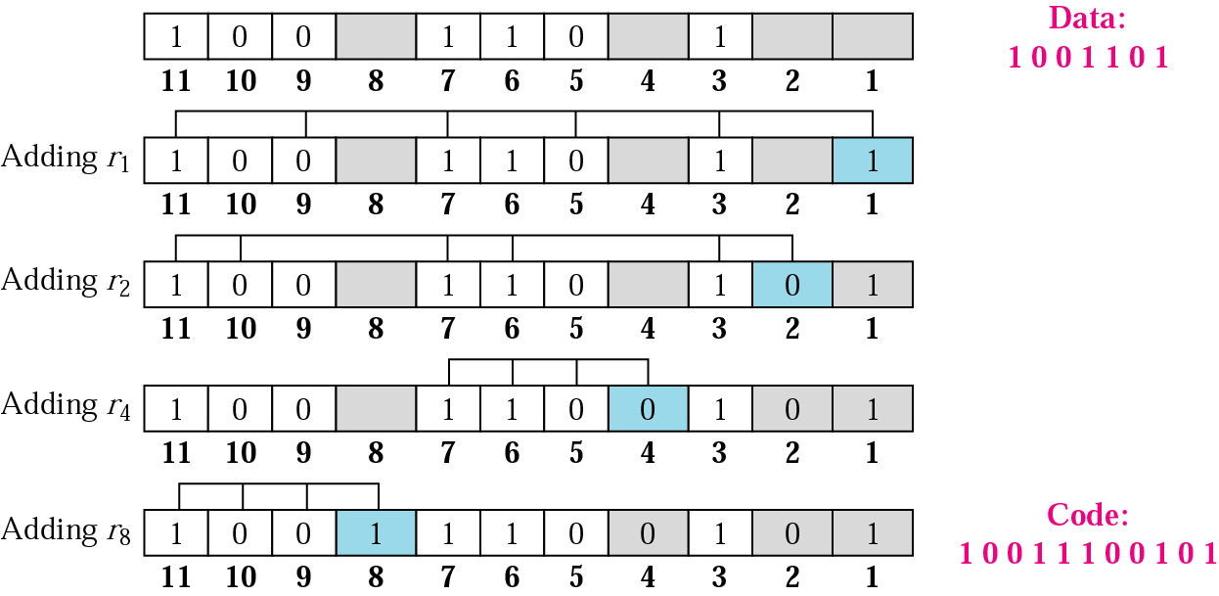
10.16 Example of redundancy bit calculation

Slide 66
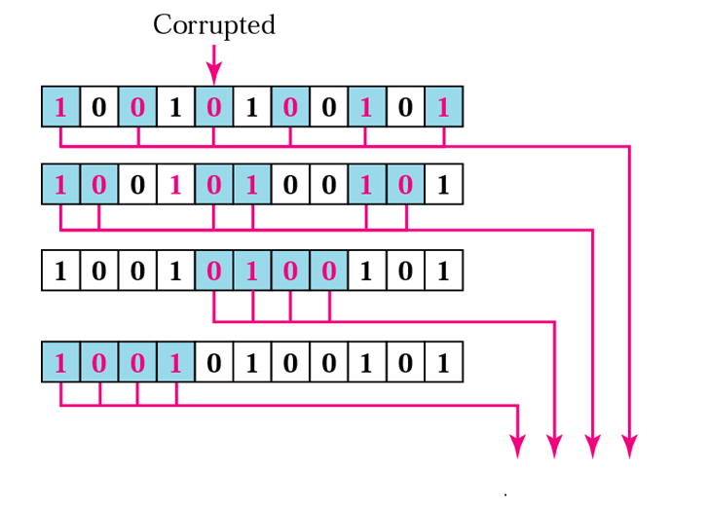
10.17 Error detection using Hamming code

Slide 67
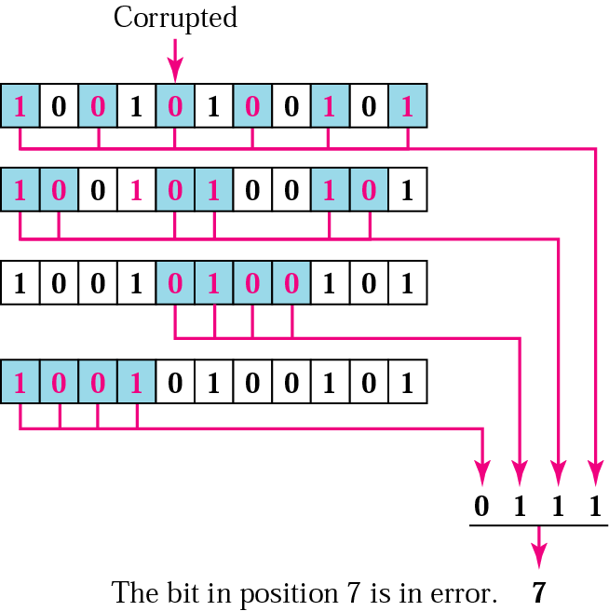
10.17 Error detection using Hamming code

Slide 68
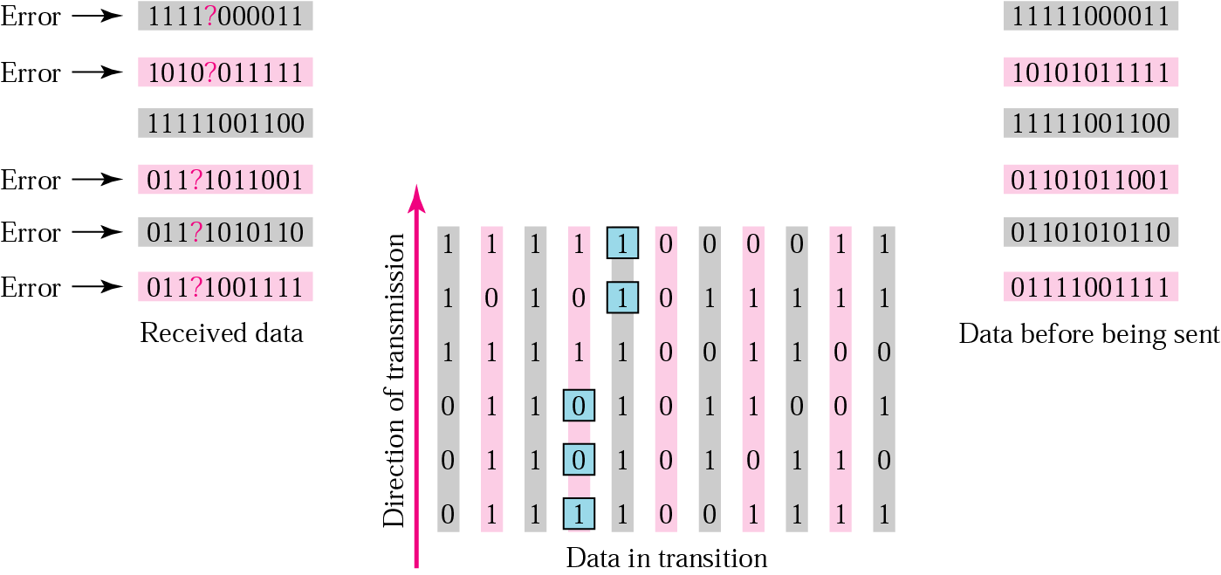
10.18 Burst error correction example

Slide 69
Review Questions
1. Why do you need error detection?
2. Explain different types of Errors?
3. Explain the use of parity check for error detection?
4. What are the different types of errors detected by parity check?

Slide 70
Review Questions
5. Draw the LFSR circuit to compute a 4 bit CRC with the polynomial X^4 + X^2 + 1?
6. Obtain the 4-bit CRC code word for the data bit sequence 10011011100 (leftmost bit is the least significant) using the generator polynomial given in the previous problem.
7. How many redundant bits are to be sent for correcting a 32-bit data unit using Hamming code?

